Slide 1
ABBVIE NETWORK
July 2023

Slide 2
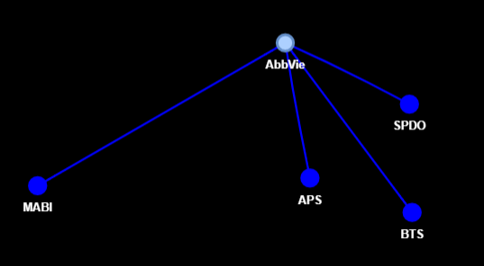
ABBVIE
Projects

Slide 3
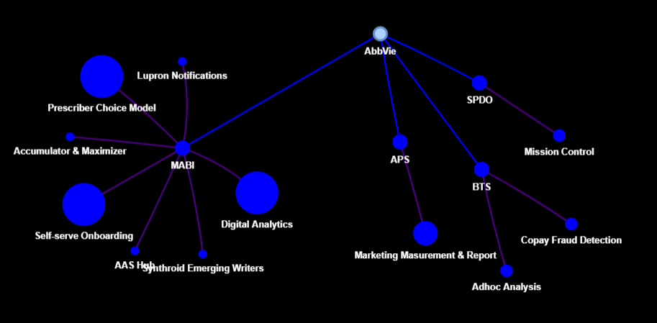
ABBVIE
Projects
Projects & Problems

Slide 4
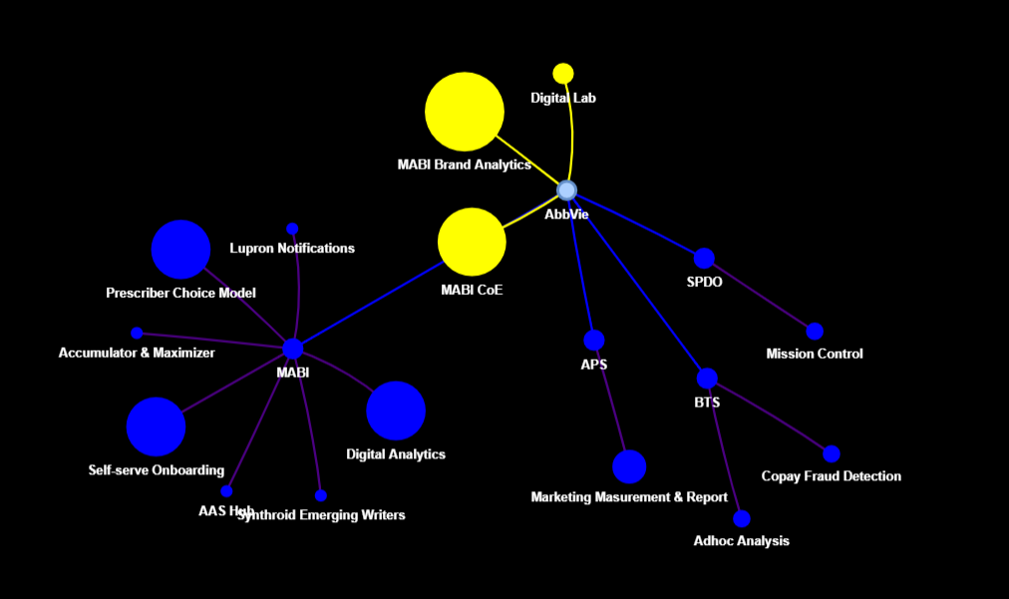
ABBVIE
Projects
Projects & Problems
Expanding Projects

Slide 5
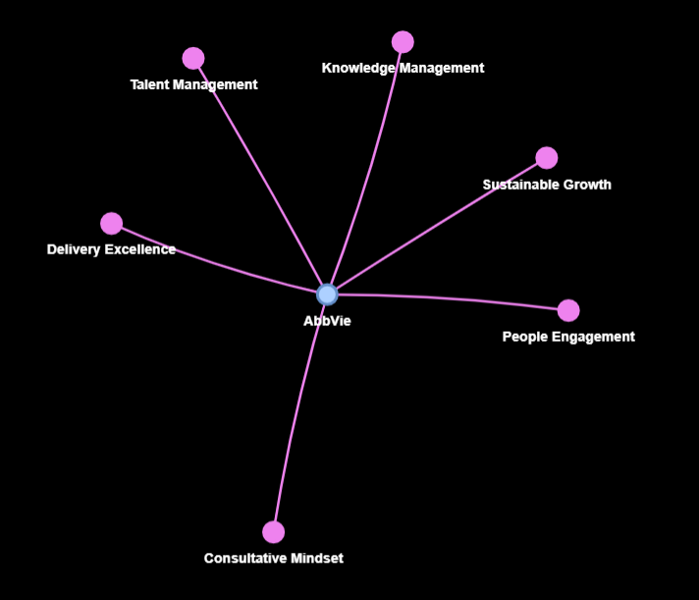
ABBVIE
Goals

Slide 6
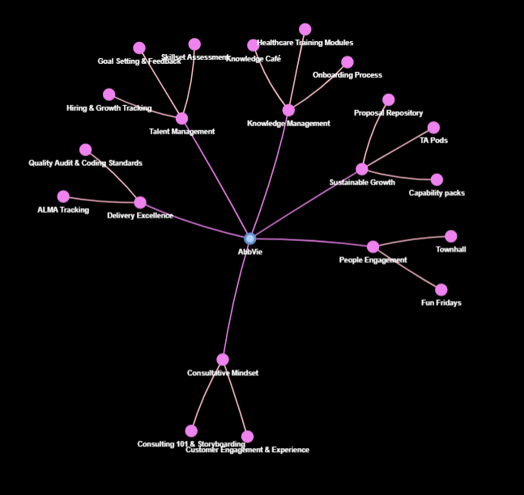
ABBVIE
Goals
Goals & Initiatives

Slide 7
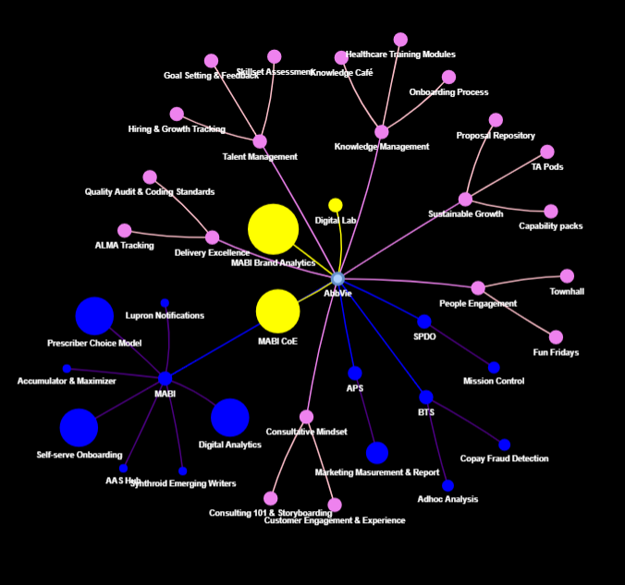
ABBVIE
Projects
Projects & Problems
Expanding projects
Goals
Goals & Initiatives
The Network

